Slide 1
The insight toolkit image registration framework
Brian B. Avants
Nicholas J. Tustison
Michael Stauffer
Gang Song
Baohua Wu
James C. Gee

Slide 2


Definition from wiki
Image registration is the process of transforming different sets of data into one coordinate system. Data may be multiple photographs, data from different sensors, times, depths, or viewpoints…

Slide 3
Background
Insight Toolkit(ITK) is an open-source, cross-platform library that provides developers with an extensive suite of software tools for image analysis. Developed through extreme programming methodologies, ITK builds on a proven, spatially-oriented architecture for processing, segmentation, and registration of scientific images in two, three, or more dimensions.
The latest version is 5.1.2 (12/8 2020)
language：c++, python, javascript

Slide 4
Motivation
The software was selected randomly by me at first time. I finally decided to introduce the topic because it can use python language which is slightly familiar to me. uhhh... In fact, I haven’t used python since last semester and almost forgot how to do.
However, ITK doesn’t provide any visualization functionalities. If applications requires visualization, we need to install another software, such as 3D Slicer, The Visualization Toolkit (VTK),and etc. additionally. Accidently, I found an easy-to-start software based on ITK, SimpleITK, which supports image IO, basic image manipulation,ITKv4 registration framework, and so on.

Slide 5
Why do I use SimpleITK instead of ITK.
SimpleITK can easily visualize image using Jupyter notebook without installing additionally toolkit.
There are many tutorial videos about how to use python packages SimpleITK on the official YouTube’s channel named SimpleITK, furthermore, most of examples on official ITK website are programmed in C++.
I only want to demonstrate simple image registrations with light weight operations.

Slide 6
Purpose
Core software components
ITK transforms should be unified
Image registration should be achievable in one step
Registration mappings should be applicable to a number of popular data types, including DTI
Affine and deformable similarity metrics should look as similar as possible
Users should be able to combine multiple similarity metrics, some of which may operate on different data types
Optimizers and transformations should interact flexibly
GPU and multi-core acceleration will open up new applications for image registration
Improve memory efficiency in optimization framework

Slide 7
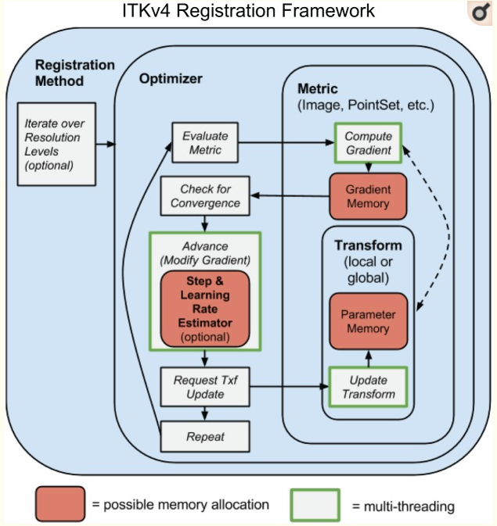
Core software components

Slide 8
ITK transforms should be unified
Each ITK⁴ transform now has either global support (affine transform) or local support (a displacement field transform). If any map in a composite transform has global support then the composite transform has global support.
Both “fixed” and “moving” images may have initial transforms. This allows one to reduce “registration bias” that may be induced by asymmetric interpolation.

Slide 9
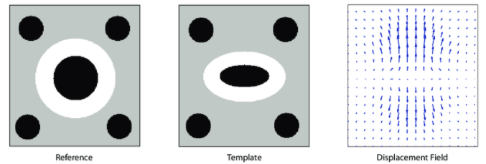
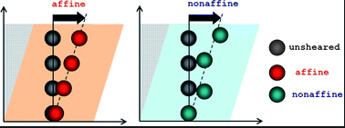
Local v.s. Global
Affine : it preserves parallelism, collinearity
deformation(變形)
Left figure:https://www.researchgate.net/figure/The-concept-of-displacement-fields-A-displacement-field-gives-for-every-pixel_fig1_267946997
Right figure:https://pubs.rsc.org/en/content/articlelanding/2012/sm/c2sm25364j#!divAbstract
Notes:
Each ITK⁴ transform now has either global support (affine transform) or local (or compact) support (a displacement field transform)

Slide 10
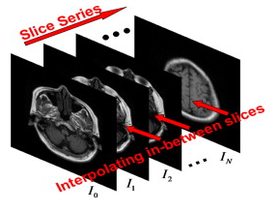
Asymmetric interpolation
In medical imaging, a slice sequence of an organ or tissue is obtained with high resolution using CT, MRI, or other modalities.
The spacing between neighboring slices is often much larger than the pixel size which is attributed to the capability of the imaging devices, or time/storage/dose limitation.
To obtain volume data with isotropic dimensions for 3D structure reconstruction, we need to interpolate several in-between slices
slice
0.1mm
0.2mm
slice
0.3mm
0.1mm
slice
0.1mm
Reference:
https://www.sciencedirect.com/science/article/pii/S0898122113002538
https://forum.dcmtk.org/viewtopic.php?t=2179
Notes:
任意兩個切片中間都會因為機器還是甚麼的問題而造成切的厚度不相同或者切出來的間隔太大，這時我們要重建成3D影像必須去除這些缺失的切片，以內插方式補足資訊，當然這無法完美補成3D圖案，因此會有registration bias

Slide 11
interpolation
Scene-based
Early:the pixel intensity of in-between slices is determined directly from the pixel intensity of the given slices at the identical position.
Middle: cubic spline and other polynomials were used in medical image interpolation.
In recent years, the kriging method in statistics was used in gray value interpolation
Pros and cons:simple.fast but acc is low and without considering the shape feature deformation. Hence, the resultant in-between slices have blurring effects at the object boundary.
Object-based

Slide 12
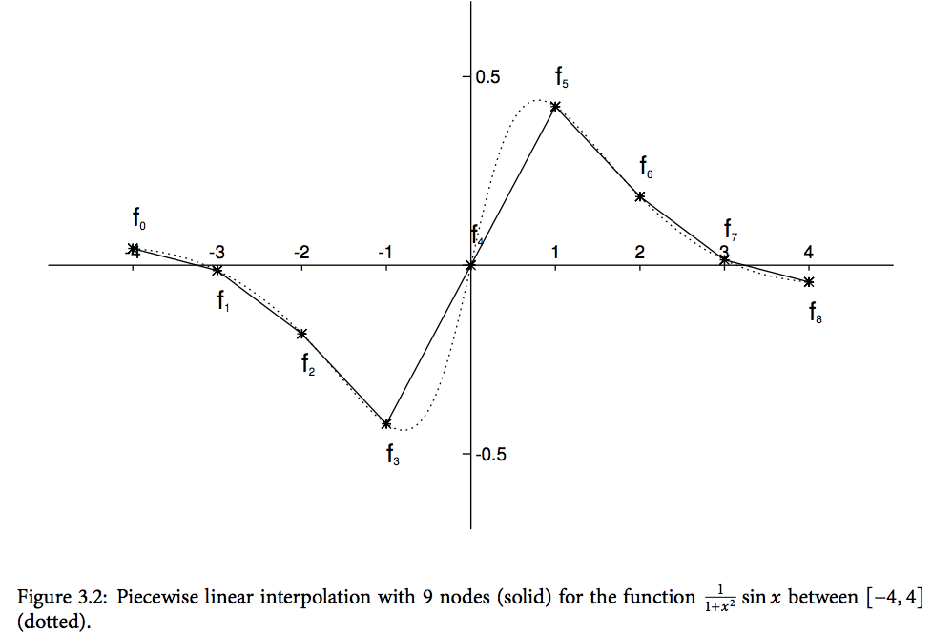
Spline interpolation
Linear
cubic
Reference:https://mropengate.blogspot.com/2015/04/cubic-spline-interpolation.html

Slide 13

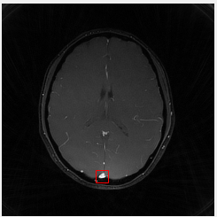
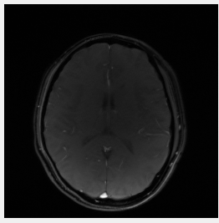
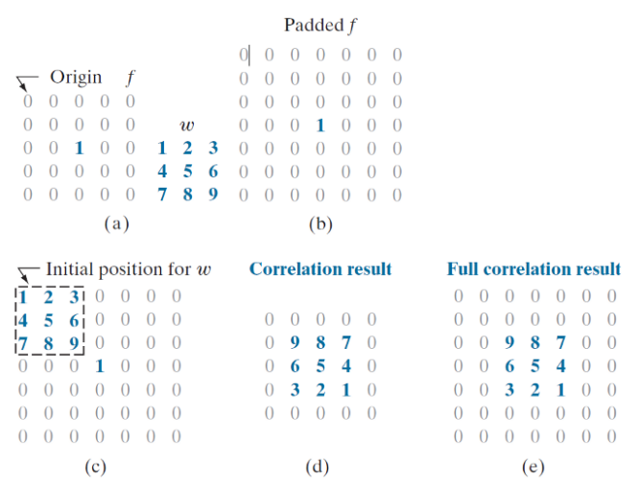
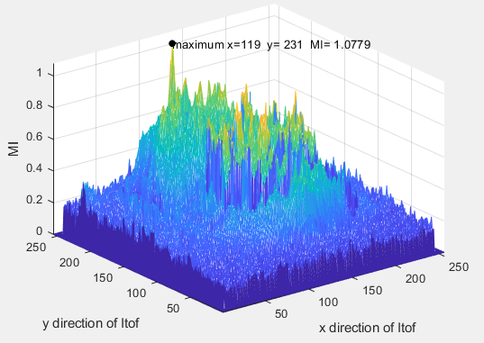
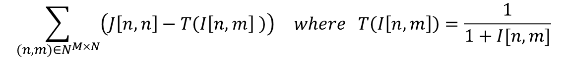
Similarity metrics
Mean squares Pattern intensity
Mutual information Normalized correlation
$$\sum_{(n,m)∈N^{M×N}}{\left(J\left[n,n\right]−T\left(I\left[n,m\right] \right)\right)} where T\left(I\left[n,m\right]\right)=\frac{1}{1+I[n,m]}$$
Reference:
https://datascience.stackexchange.com/questions/48642/how-to-measure-the-similarity-between-two-images
https://itk.org/Doxygen413/html/ImageSimilarityMetricsPage.html
Figure: h ttps://towardsdatascience.com/convolution-vs-correlation-af868b6b4fb5

